Slide 1
Introduction to UML
Notes:
Introduce myself

Slide 2
Overview
What is Modeling?
What is UML?
A brief history of UML
Understanding the basics of UML
UML diagrams
UML Modeling tools
Notes:
Overview of my presentation:
- Essence of modeling, UML, history of UML, Basics of UML, UML modeling tools

Slide 3
MODEL
A model is an abstract representation of system, constructed to understand the system prior to building or modifying it.
Models can represent static or dynamic situations.

Slide 4
A static model can be viewed as a snapshot of s system’s parameters at rest or at a specific point in time.
A dynamic model can be viewed as a collection of procedures or behaviors that taken together, reflect the bahavior of s system over time.

Slide 5
Modeling
Building a model for a software system prior to its construction is as essential as having a blueprint for building a large building.
Good models are essential for communication among project teams.
As complexity of systems increases, so does the importance of good modeling techniques.

Slide 6
Modeling
Describing a system at a high level of abstraction
  A model of the system
  Used for requirements and specifications
Object – oriented methodology is a set of methods, models and rules for developing systems.
Modeling is the process of describing an existing or proposed system.
Notes:
1.
Describing the system at abstract level to comprehend its complexity
2.
Necessary to manage complexity
Good for quick understanding of the systems
Less chances of conflicting views b/w end-user and system designers

Slide 7
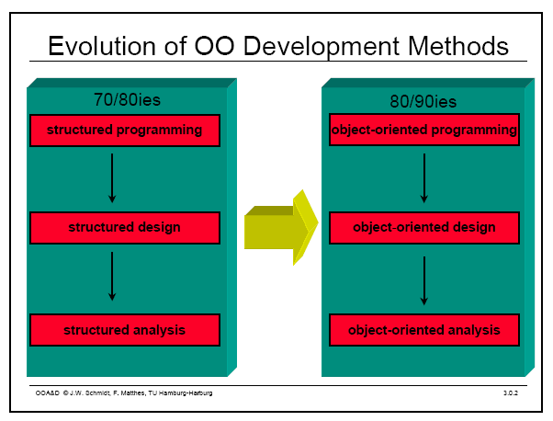
Object Oriented Modeling
Notes:
Evolution of analysis and design techniques
Transition from structured programming to object oriented programming

Slide 8
What is UML?
UML stands for “Unified Modeling Language”
It is a industry-standard graphical language for specifying, visualizing, constructing, and documenting the artifacts of software systems
The UML uses mostly graphical notations to express the OO analysis and design of software projects.
Simplifies the complex process of software design
Notes:
. What does UML stand for?
. Industry standard
. Graphical notation
. Modeling tool … simplifies software design process

Slide 9
Why UML for Modeling
Use graphical notation to communicate more clearly than natural language (imprecise) and code(too detailed).
Help acquire an overall view of a system.
UML is not dependent on any one language or technology.
UML moves us from fragmentation to standardization.
Notes:
. More precise than natural language … less detailed than source code
. Not dependent on any language
. Standardized by various groups

Slide 10
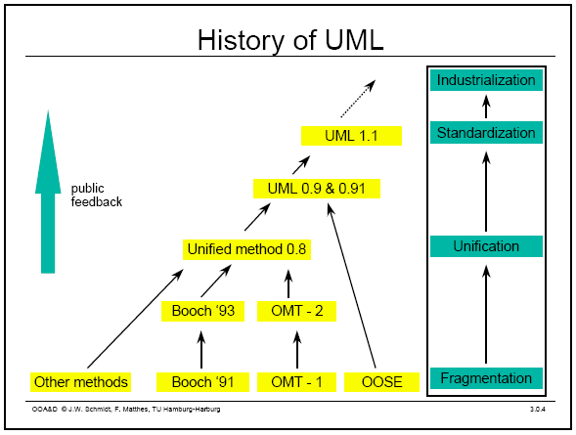
History of UML
Notes:
History:
- Rumbaugh – OMT – object modeling technique
Jacobson – OOSE
UML … unified approach since 1995
UML 1.5 current … UML 2.0 by the end of 2004

Slide 11
Types of UML Diagrams
Use Case Diagram
Class Diagram
Sequence Diagram
Activity diagram
Component diagram
Deployment diagram

Slide 12
Use Case Diagram
Used for describing a set of user scenarios
Mainly used for capturing user requirements
Work like a contract between end user and software developers

Slide 13
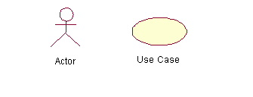
Use Case Diagram (core components)
Actors: A role that a user plays with respect to the system, including human users and other systems. e.g.,inanimate physical objects (e.g. robot); an external system that needs some information from the current system.
Use case: A set of scenarios that describing an interaction between a user and a system, including alternatives.
System boundary: rectangle diagram representing the boundary between the actors and the system.

Slide 14
Use Case Diagram(core relationship)
Association: communication between an actor and a use case; Represented by a solid line.
Generalization: relationship between one general use case and a special use case (used for defining special alternatives)
Represented by a line with a triangular arrow head toward the parent use case.

Slide 15
Use Case Diagram(core relationship)
Include: a dotted line labeled <<include>> beginning at base use case and ending with an arrows pointing to the include use case. The include relationship occurs when a chunk of behavior is similar across more than one use case. Use “include” in stead of copying the description of that behavior.
<<include>>
Extend: a dotted line labeled <<extend>> with an arrow toward the base case. The extending use case may add behavior to the base use case. The base class declares “extension points”.
<<extend>>

Slide 16
Use Case Diagrams
Use Case
Boundary
Actor
Library System
Borrow
Employee
Client
Order Title
Fine Remittance
Supervisor
A generalized description of how a system will be used.
Provides an overview of the intended functionality of the system

Slide 17
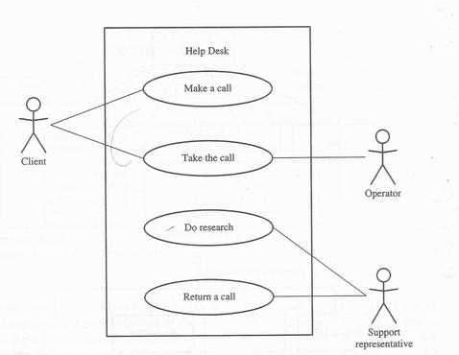

Slide 18
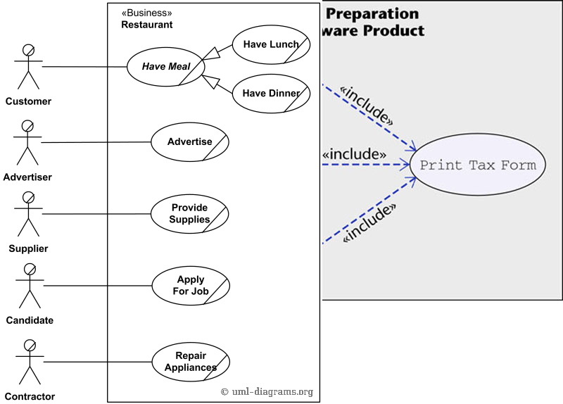

Slide 19
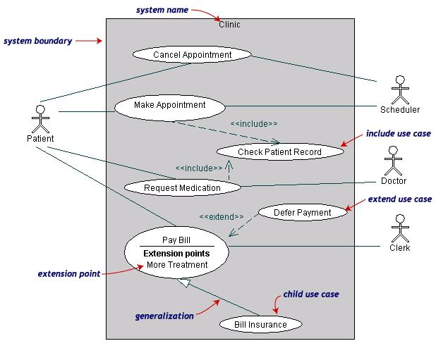

Slide 20
Use Case Diagrams(cont.)
Pay Bill is a parent use case and Bill Insurance is the child use case. (generalization)
Both Make Appointment and Request Medication include Check Patient Record as a subtask.(include)
The extension point is written inside the base case
Pay bill; the extending class Defer payment adds the behavior of this extension point. (extend)

Slide 21
Restaurant
UML Use Case Diagram Example

Slide 22
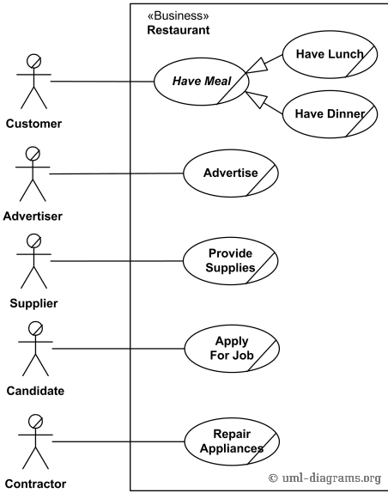

Slide 23
Hospital Management
UML Use Case Diagram Example

Slide 24
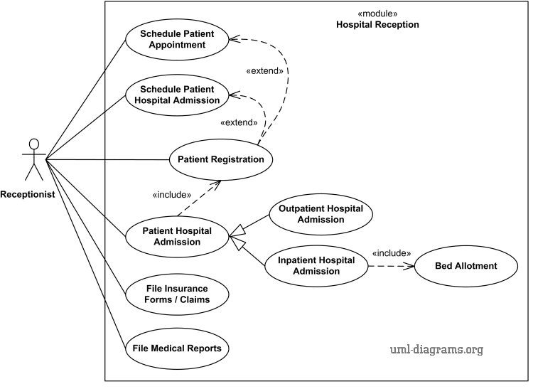

Slide 25
Class diagram
Used for describing structure and behavior in the use cases
Provide a conceptual model of the system in terms of entities and their relationships
Used for requirement capture, end-user interaction
Detailed class diagrams are used for developers

Slide 26
Class representation
Each class is represented by a rectangle subdivided into three compartments
  Name
  Attributes
  Operations
Modifiers are used to indicate visibility of attributes and operations.
  ‘+’ is used to denote Public visibility (everyone)
  ‘#’ is used to denote Protected visibility (friends and derived)
  ‘-’ is used to denote Private visibility (no one)
By default, attributes are hidden and operations are visible.

Slide 27
An example of Class
Name
Account_Name
- Customer_Name
- Balance
Attributes
+addFunds( )
+withDraw( )
+transfer( )
Operations

Slide 28
OO Relationships
There are two kinds of Relationships
  Generalization (parent-child relationship)
  Association (student enrolls in course)
Associations can be further classified as
  Aggregation
  Composition

Slide 29
OO Relationships: Generalization
Supertype
Example:
Customer
Regular
Customer
Loyalty
Customer
Subtype1
Subtype2
or:
Customer
- Generalization expresses a parent/child relationship among related classes.
- Used for abstracting details in several layers
Regular
Customer
Loyalty
Customer

Slide 30
OO Relationships: Association
Represent relationship between instances of classes
  Student enrolls in a course
  Courses have students
  Courses have exams
  Etc.
Association has two ends
  Role names (e.g. enrolls)
  Multiplicity (e.g. One course can have many students)
  Navigability (unidirectional, bidirectional)

Slide 31
Association: Multiplicity and Roles
student
1
*
University
Person
0..1
*
employer
teacher
Role
Multiplicity
Symbol Meaning
1 One and only one
0..1 Zero or one
M..N From M to N (natural language)
* From zero to any positive integer
0..* From zero to any positive integer
1..* From one to any positive integer
Role
“A given university groups many people; some act as students, others as teachers. A given student belongs to a single university; a given teacher may or may not be working for the university at a particular time.”

Slide 32
Class Diagram
Name
Order
class
Multiplicity: mandatory
Attributes
-dateReceived
*
Customer
-isPrepaid
1
-number :String
-name
-price : Money
-address
Operations
+dispatch()
Association
+creditRating() : String()
+close()
1
{if Order.customer.creditRating is
Generalization
"poor", then Order.isPrepaid must
be true }
Corporate Customer
Personal Customer
Constraint
(inside braces{}}
-contactName
-creditCard#
-creditRating
Multiplicity:
Many value
-creditLimit
+remind()
+billForMonth(Integer)
Multiplicity: optional
0..1
*
*
Employee
OrderLine
-quantity: Integer
*
1
Product
-price: Money
-isSatisfied: Boolean
[from UML Distilled Third Edition]

Slide 33
Association: Model to Implementation
*
4
Student
Course
has
enrolls
Class Student {
Course enrolls[4];
}
Class Course {
Student have[];
}

Slide 34
OO Relationships: Composition
Composition: expresses a relationship among instances
of related classes. It is a specific kind of Whole-Part
relationship.
It expresses a relationship where an instance of the
Whole-class has the responsibility to create and initialize
instances of each Part-class.
It may also be used to express a relationship where instances
of the Part-classes have privileged access or visibility to
certain attributes and/or behaviors defined by the
Whole-class.
Composition should also be used to express relationship where
instances of the Whole-class have exclusive access to and
control of instances of the Part-classes.
Composition should be used to express a relationship where
the behavior of Part instances is undefined without being
related to an instance of the Whole. And, conversely, the
behavior of the Whole is ill-defined or incomplete if one or
more of the Part instances are undefined.
Whole Class
Class W
Class P₁
Class P₂
Part Classes
Example
Automobile
Engine
Transmission
[From Dr.David A. Workman]

Slide 35
OO Relationships: Aggregation
Container Class
Class C
Aggregation: expresses a relationship among instances
of related classes. It is a specific kind of Container-Containee
relationship.
It expresses a relationship where an instance of the
Container-class has the responsibility to hold and maintain
instances of each Containee-class that have been created
outside the auspices of the Container-class.
Aggregation should be used to express a more informal
relationship than composition expresses. That is, it is an
appropriate relationship where the Container and its
Containees can be manipulated independently.
Aggregation is appropriate when Container and Containees have no special access privileges to each other.
AGGREGATION
Class E₁
Class E₂
Containee Classes
Example
Bag
Apples
Milk
[From Dr.David A. Workman]

Slide 36
Aggregation vs. Composition
  Composition is really a strong form of aggregation
    components have only one owner
    components cannot exist independent of their owner
    components live or die with their owner
    e.g. Each car has an engine that can not be shared with other cars.
  Aggregations may form "part of" the aggregate, but may not be essential to it. They may also exist independent of the aggregate.
  e.g. Apples may exist independent of the bag.

Slide 37
Sequence Diagram
  Sequence diagrams demonstrate the behavior of objects in a use case by describing the objects and the messages they pass.
The horizontal dimension shows the objects participating in the interaction.
The vertical arrangement of messages indicates their order.
The labels may contain the seq. # to indicate concurrency.

Slide 38
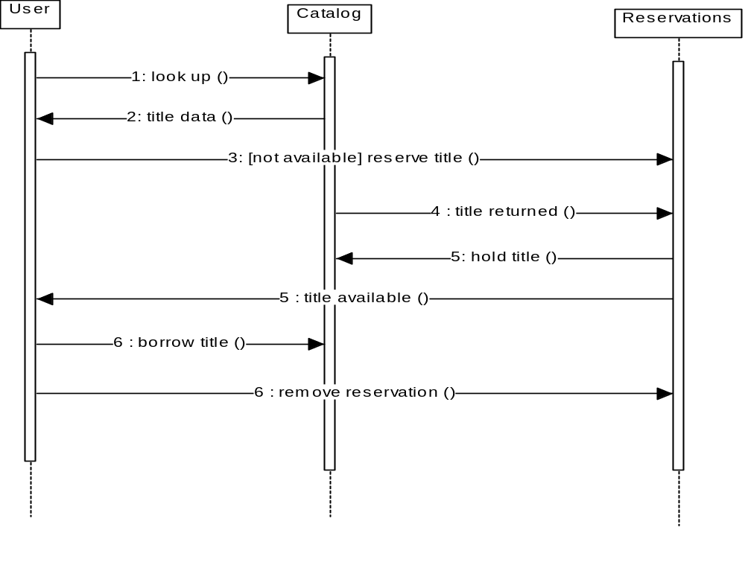
Message

Slide 39
Activity diagram
Activity diagram is another important diagram in UML to describe dynamic aspects of the system.
Activity diagram is basically a flow chart to represent the flow form of one activity to another activity.
The activity can be described as an operation of the system.

Slide 40
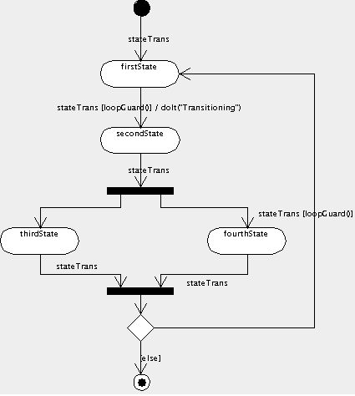

Slide 41
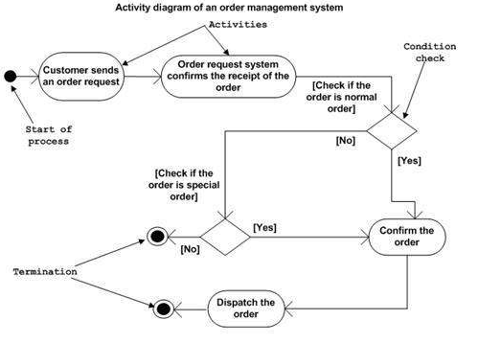

Slide 42
Travel agency sceneario

Slide 43
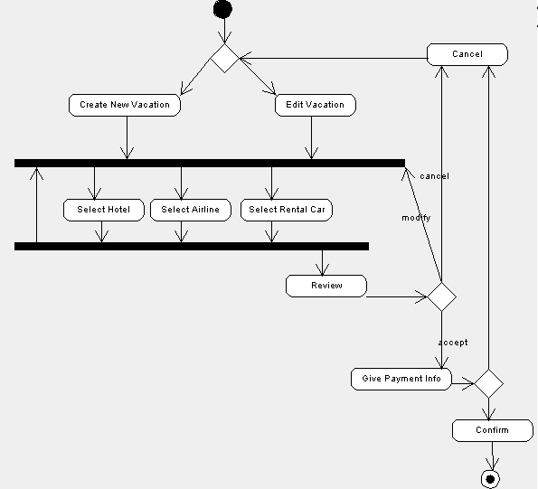

Slide 44
Component diagram
Component diagrams are different in terms of nature and behaviour.
Component diagrams are used to model physical aspects of a system.
Physical aspects are the elements like executables, libraries, files, documents etc which resides in a node.

Slide 45
So component diagrams are used to visualize the organization and relationships among components in a system. These diagrams are also used to make executable systems.
Component diagrams can also be described as a static implementation view of a system.

Slide 46
It does not describe the functionality of the system but it describes the components used to make those functionalities.
Component diagrams are used during the implementation phase of an application. But it is prepared well in advance to visualize the implementation details.

Slide 47
Basic Component Diagram Symbols and Notations
Component
A component is a logical unit block of the system, a slightly higher abstraction than classes. It is represented as a rectangle with a smaller rectangle in the upper right corner with tabs or the word <component> written above the name of the component to help distinguish it from a class.

Slide 48


Slide 49
Interface
An interface (small circle or semi-circle on a stick) describes a group of operations used (required) or created (provided) by components. A full circle represents an interface created or provided by the component. A semi-circle represents a required interface, like a person's input.

Slide 50
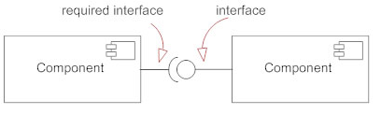

Slide 51
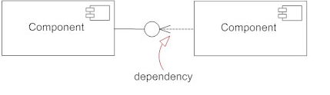
Dependencies
Draw dependencies among components using dashed arrows.

Slide 52
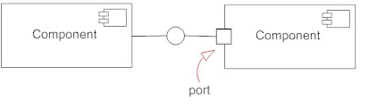
Port
Ports are represented using a square along the edge of the system or a component. A port is often used to help expose required and provided interfaces of a component.

Slide 53
Deployment Diagram
Deployment diagrams are used to visualize the topology of the physical components of a system where the software components are deployed.
deployment diagrams are used to describe the static deployment view of a system.
Deployment diagrams consist of nodes and their relationships.

Slide 54
Deployment diagrams are used for describing the hardware components where software components are deployed.
Component diagrams and deployment diagrams are closely related.
Component diagrams are used to describe the components and deployment diagrams shows how they are deployed in hardware.

Slide 55
The purpose of deployment diagrams can be described as:
Visualize hardware topology of a system.
Describe the hardware components used to deploy software components.
Describe runtime processing nodes.

Slide 56
For drawing a deployment diagram the following artifacts should be identified:
Nodes
Relationships among nodes

Slide 57
Deployment view of order management system

Slide 58
